Slide 1
CSE 12 – Basic Data Structures and Object-Oriented Design Lecture 7
Greg Miranda & Paul Cao, Winter 2021
This lecture is being recorded

Slide 2
Announcements
Quiz 7 due Friday @ 8am
Survey 3 due Friday @ 11:59pm
PA2 due tonight @ 11:59pm

Slide 3
Topics
Queue
Stacks
Other Topics
Adapter Pattern
Composition
Stacks & Queues with LinkedList

Slide 4

Queue
Queue – insertion and deletion operations are performed at two different ends

Slide 5

Is a Queue an ADT or a data structure?
ADT
Data structure
I have no idea, what's the difference again??
Notes:
All ADTs are implemented by using some data structures
ADT: QUEUE
Data Structures Used: ArrayList and LinkedList etc.

Slide 6
Queue
A queue is an ADT, in which insertion is done at one end, while deletion is performed at the other end.
Accessing the elements of queues follows a First In, First Out (FIFO) order.
Like customers standing in a line in a store, the first customer in is the first customer served.
We can only add to the end of the queue, and can only examine/remove the front of the queue.

Slide 7
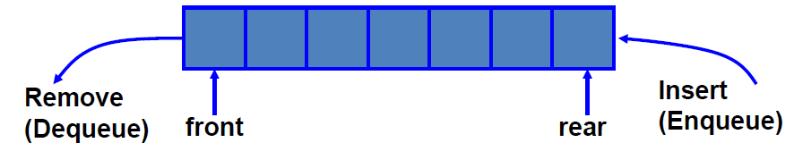
Enqueue and Dequeue
Like lines in a store, a queue has a front and a rear.
Enqueue – insert an element at the rear of the queue
Dequeue – remove an element from the front of the queue

Slide 8
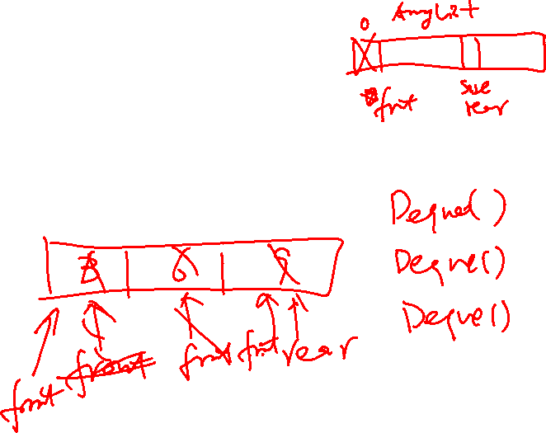
Example of Enqueue and Dequeue
Suppose we have an empty static integer queue that is capable of holding a maximum of three values. With that queue we execute the following enqueue operations.
Enqueue(3);
Enqueue(6);
Enqueue(9);

Slide 9
Enqueue(3);
Enqueue(6);
Enqueue(9);
Dequeue();
Dequeue();
Dequeue();

Slide 10
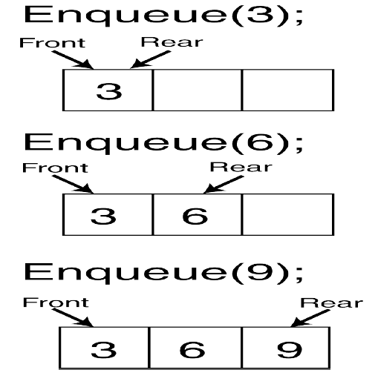
Queue State After Enqueue

Slide 11
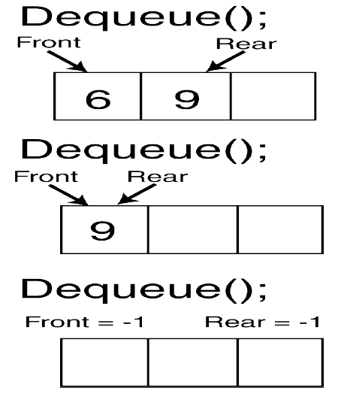
Queue State After Dequeue

Slide 12
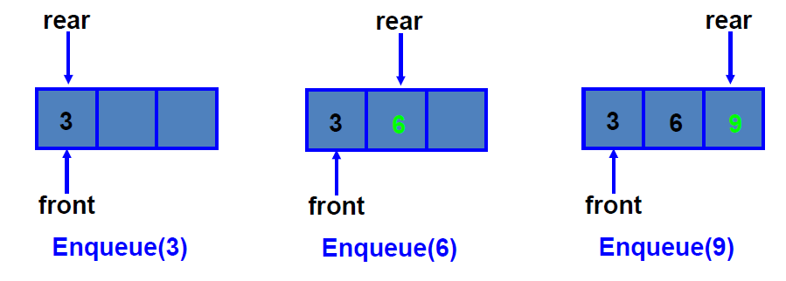
Queue Implementation of Array
When enqueuing, the front index is always fixed and the rear index moves forward in the array.

Slide 13
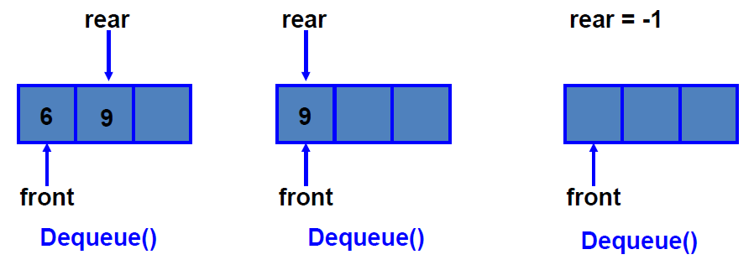
Queue Implementation of Array
When dequeuing, the front index is fixed, and the element at the front the queue is removed. Move all the elements after it by one position
.

Slide 14
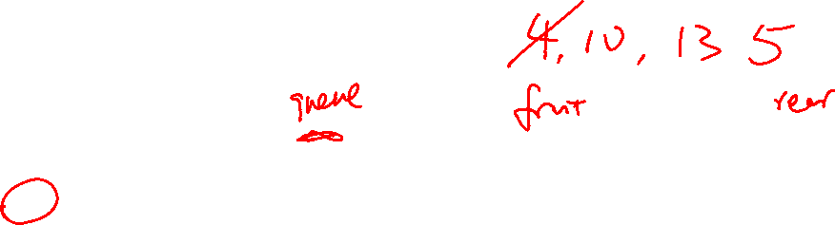
Queues
Consider doing the following operations on an initially empty queue, q:
s.enqueue(4)
s.enqueue(10)
s.enqueue(13)
s.dequeue()
s.enqueue(5)
What are the contents of the stack, from front (left) to rear (right):
4, 10, 13, 5
10, 13, 5
4, 10, 5
5, 10, 4
other

Slide 15
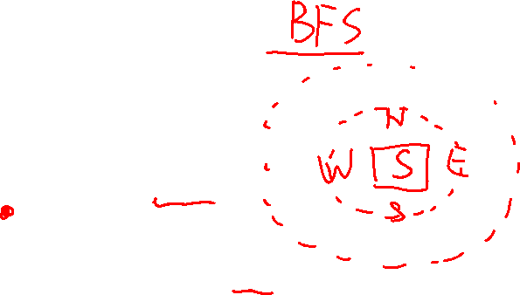
Searching with a Queue
col
col
col
col
0
1
2
3
SearchForTheExit
Initialize a Queue to hold Squares as we search
Mark starting square as visited
Put starting square on task list
While Queue is not empty
Remove square sq from task list
Mark sq as visited
If sq is the Exit, we're done!
For each of square's unseen neighbors (S, W, N, E):
Set neighbor's previous to sq
Add neighbor to Queue
row
0
row
1
row
S
2
row
Exit
3
Label the cells in the order in which they are visited by the algorithm.
What is the final path to the goal?

Slide 16
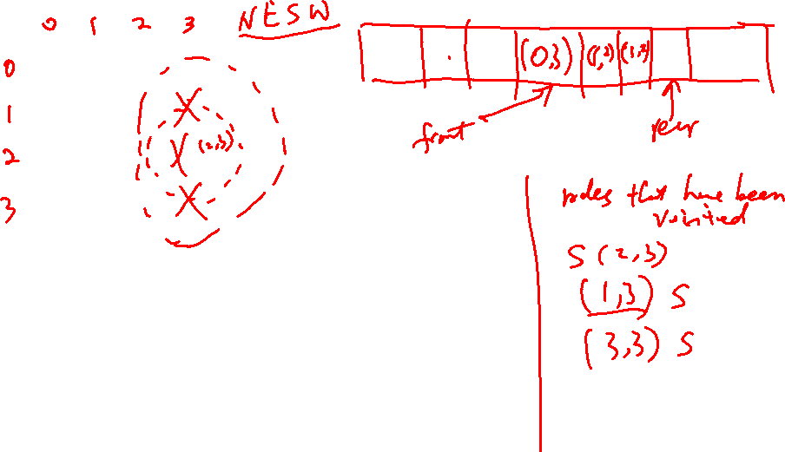
col
col
col
col
0
1
2
3
row
0
row
1
row
S
2
row
Exit
3

Slide 17
Queue - Implementation
One option: Implement the methods in the ADT from scratch.
public class MyQueue<E>{
Object[] data;
int size;
int front;
int back;
public boolean enqueue(E elem){
//if full resize
//change front
//add in the new element
}
}

Slide 18
Adapter Pattern
1

Slide 19
Adapter Pattern
Lazy Paul needs to implement the Queue Interface with the following methods:
void enqueue(E element) – add elements on to the queue.
E dequeue() – remove element from front of the queue.
int size() – return the size of the queue.
Let’s see what he can do to be as lazy as possible.

Slide 20
Adapter Pattern
Paul has access to a data structure implementation that supports the following methods. Let’s call this data structure ...........ArrayList
void add(int index, E value)
E remove(int index)
int size()

Slide 21
Inheritance?
Paul realizes that he can just make Queue extend the ArrayList and write the additional methods by using other existing methods.
Ex:
public Queue<E> extends ArrayList<E>
{
…
public E dequeue() {
E toReturn = this.contents.get(0);
this.contents.remove(0);
return toReturn;
}
…
}
Pros? Cons?

Slide 22
Inheritance
Such an implementation comes with strings attached.
The other methods in the Deque are public and accessible by anyone. But a Stack does not expose such methods! (Ex: addBack, removeBack() etc)
So Inheritance is not the best design pattern to use here.

Slide 23
Inheritance is not always the right answer
Paul has access to a data structure implementation that supports the following methods. Let’s call this data structure .....ArrayList
void add(int index, E value)
E remove(int index)
int size()

Slide 24
Adapter Pattern
Making the ArrayList variable private makes sure that users of the Queue cannot access the ArrayList or its methods.
Only the Queue methods are public and therefore usable by clients.
You can happily use ArrayList within Queue and pass on operations to it.
A queue “is-a” ArrayList
A queue has-a ArrayList!

Slide 25
Adapter Pattern – Example
public class Queue<E> implements QueueInterface<E> {
private ArrayList<E> container;
…
public void enqueue(E element) {
this.contents.add(this.contents.size(), element);
}
}
This is called ‘delegation’. The enqueue method of Queue is delegating the task to add method of ArrayList

Slide 26

And no one needs to know..
Every one thinks I implemented Queue from scratch

Slide 27
Mapping Attributes
Before deciding on what methods to use, one needs to map the corresponding attributes.
For example: To use the ArrayList as a Stack, we need to map the Top of the stack to some position in the list (front or back—our choice, but how to choose?)

Slide 28
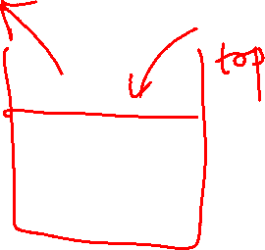
Mapping methods
Once this is done, we can map the methods on top of the stack to methods operating on the head of the List.
If we choose the front….
push -> add
pop -> remove
peek -> get

Slide 29
Adapter Pattern Summary
You would like to implement an Interface A.
You have an implementation B that implements another interface C which defines methods very much similar to the methods in A but differ slightly (like name).
You use an instance of B inside your class that implements A and delegate tasks to it.
Your class A “has a” class B.

Slide 30
Adapt Queue from Deque
enqueue -> addLast
dequeue -> removeFirst
peek -> peekFirst

Slide 31
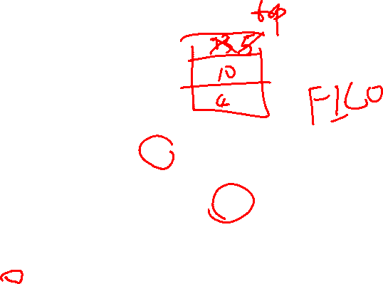
import java.util.ArrayList;
public interface Stack<E> {
void push(E element);
E pop();
int size();
}
// IDEA: Use array lists to implement both
class ALStack<E> implements Stack<E> {
}
A stack has two operations, push and pop. Pushing adds an element to the top of the stack, and pop removes the top element and returns it.
Stack<Integer> s = new ALStack<>();
s.push(4);
s.push(10);
s.push(13);
Integer i = s.pop();
s.push(5);
Integer i2 = s.pop();
What number is stored in i?
A: 4 B: 10 C: 13 D: 5 E: Something else
What number is stored in i2?
A: 4 B: 10 C: 13 D: 5 E: Something else
What is the contents of the stack? (starting at the top)
A. 5, 13, 10, 4
B. 10, 4
C. 5, 13
D. 13, 10, 4
E. other

Slide 32
Other Topics
Adapter Pattern
Composition
Stacks & Queues with LinkedList

